Slide 1
8. Knowledge Graph Alignment
John P. McCrae
CT5166

Slide 2
Course structure
9th Sep | Introduction to Knowledge Graphs | 21st Oct | Inductive reasoning
16th Sep | Models for Knowledge Graphs | 28th Oct | KG Creation (no lab on Monday)
23rd Sep | Querying and Serialization | 4th Nov | KG Alignment
30th Sep | Schemas | 11th Nov | Publishing and Linked Open Data
7th Oct | Deductive reasoning | 18th Nov | Linguistic Linked Open Data
14th Oct | No Lecture | 25th Nov | Enterprise Knowledge Graphs

Slide 3
Introduction

Slide 4
What is knowledge graph alignment?
KG 2
animal
mammal
cat
dog
dog
corgi
terrier
poodle
KG 1

Slide 5
Problem statement
Given two graphs, O₁ = { e₁,...,e_{n} } and O₂ = { e’₁,...,e’_{m} }
We wish to find a set of 4-tuples {<e_{i}, e’_{j}, n, R>}
Where
e_{i} and e’_{j} are two elements from each ontology
n is a confidence score
R denotes a relation type, for example equivalence (=), more general (⊒), related (⊓) or disjoint (⊥)

Slide 6


Why align knowledge graphs?
Integrating catalogues from different stores

Slide 7
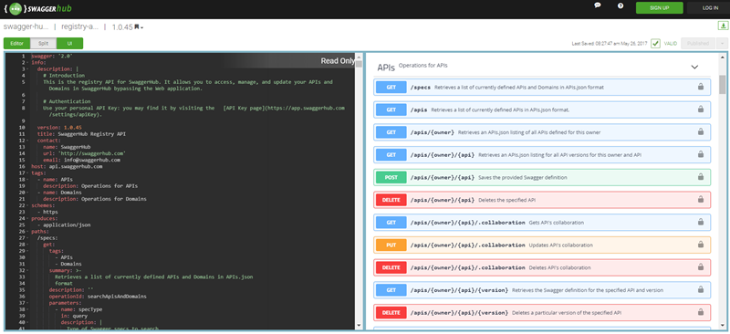
Why align knowledge graphs?
Making web services that talk to each other

Slide 8



Why align knowledge graphs?
What was that film set in Galway starring the guy from “In Bruges”?
The Guard!
Intelligent agents

Slide 9
Element-level matching
animal
animal
cat
feline mammal usually having thick soft fur and no ability to roar
house cat
domesticated feline
Element-level matching focuses on the properties of the two elements being linked
Titles
Descriptions
Key properties
tabby
tabby

Slide 10
Structure-level matching
animal
animal
cat
feline mammal usually having thick soft fur and no ability to roar
e₁
house cat
domesticated feline
e₂
tabby
tabby
Structure-level matching uses the context of the entities to match
This is done iteratively:
Make ‘easy’ links first

Slide 11
Discussion
What methods could you use to match ontology elements?
Are they element- or structure-based?

Slide 12
Element-level matching

Slide 13
String-based techniques
We can use natural language processing techniques to compare string similarity
Linguistic pre-processing (tokenization, lemmatization, stop word removal)
n-gram word/character overlap
Levenshtein edit distance
Deep learning techniques (‘Siamese networks’)

Slide 14
Constraint-based techniques
Matching based on the logical constraints of the elements
classes don’t match properties
don’t match Wikipedia disambiguation pages
verbs don’t match nouns

Slide 15

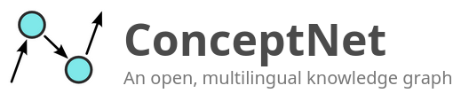

External Techniques
Yes!
Could test match exam?
Yes!
Yes!

Slide 16
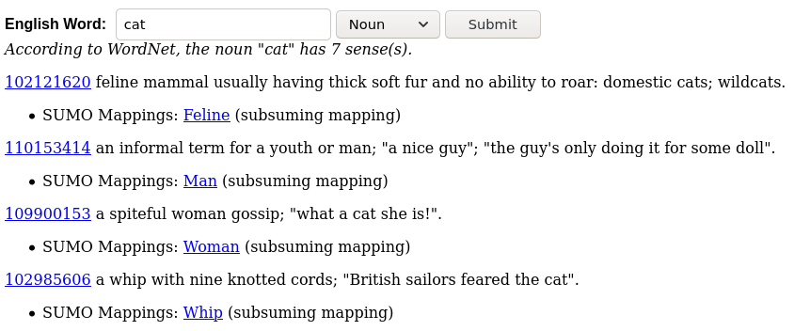
Upper-level ontologies
Upper-level ontologies such as SUMO and DOLCE provide formal modelling of concepts
This could be exploited for matching if both ontologies are formalized

Slide 17
Task
:prop1 a owl:DatatypeProperty ;
rdfs:label “address”@en ;
skos:description “written directions for finding some location”@en .
:class1 a owl:Class ;
rdfs:label “address”@en ;
skos:description “the act of delivering a formal spoken communication to an audience” @en .
What criteria could you use to help with this matching these two KG sections?
:destination a rdf:Property ;
rdfs:label “postal address”@en , “address”@en ;
skos:description “collection of information that describes the location of a building, apartment, or other structure” @en .
:address a owl:Class ;
rdfs:label “speech”@en ;
skos:description “address delivered to an audience”@en .

Slide 18
Structure-based matching

Slide 19
Unique assignment (bijection)
We disallow two matches to the same target
Formally, if we have a score p_{ij} for each link, we can find the unique assignment that maximizes Σp_{ij}.
What do you think is the computational complexity of this?
Hungarian method (Munkres algorithm) can solve this in O(n³)

Slide 20
Link Prediction using Personalized PageRank
0.25
Step 1
Add links that match labels exactly once.
0.5
0.0
0.0
0.4
animal
animal
1.0
0.0
0.5
0.0
0.25
Step 2
Perform a random walk from one node
cat
house cat
0.25
0.5
0.0
0.0
0.4
tabby
tabby
Step 3
Add links that have a high graph similarity
NB. link constraints should be considered also

Slide 21
Personalised PageRank algorithm
For each node initialise d⁰_{i}=0 except for the start node d⁰_{s}=1
For some number of steps, i = 1,…,m
Set d^{i}_{n}= 0 for all nodes
For each node n and its neighbours e ∈ N_{n}
Set d^{i}_{e} ← d^{i}_{e} + d^{i-1}_{n}(1 - η) /|N_{n}|
Set d^{i}_{e} ← d^{i}_{e} + ηd^{i-1}_{n}
Return d^{m}
η is the likelihood of the random walker not moving
Note: There are many other methods of graph distance and link prediction not covered here!

Slide 22
Task
a
b
a
Apply the link prediction algorithm to this problem?
What is the best unique assignment for b?
c
d
x
y
d

Slide 23
Logic-based techniques
If the ontologies have a lot of axioms we can use this to assess a proposed alignment, e.g.,
Vito has (at least) 4 (distinct) children.
Mary has no children
If we add the alignment Vito = Mary, then we get a contradiction.
But less useful in practice as:
Few ontologies really have such strong conditions
Reasoning about invalid alignments is hard

Slide 24
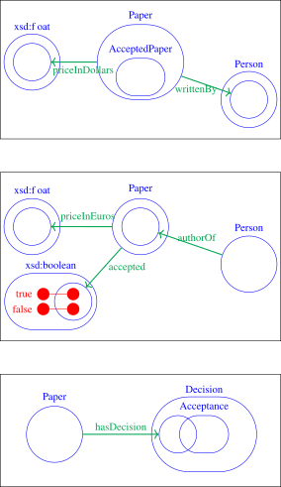
Complex Alignment
Many ontologies do not match through simple links (see right)
May need to match multiple elements simultaneously
Infer rules for how elements match
Source: Thiéblin et al. http://semantic-web-journal.org/system/files/swj2164.pdf

Slide 25
Ontology Matching

Slide 26
Scalability of Alignment
How would you solve this?
Large ontologies/knowledge graphs can be hard to align,
e.g., 1,000 entities ✕ 1,000 entities = 1,000,000 potential alignments
Filtering
Use a very cheap function to filter alignments
Blocking
Group entities by matching criteria such as keywords
Locality/Divide & Conquer
Split ontologies into smaller sub-ontologies using graph matches

Slide 27
Examples of scaling tricks
Use a cheap function, e.g., longest common subsequence to match the strings:
LCS(animal, house cat) = 1
LCS(animal, animal) = 6
animal
animal
Block using keywords, e.g., “cat”, “animal”, “tabby”
cat
house cat
tabby
tabby
Use a minimum graph distance
d(cat, house cat) = 4
d(tabby, house cat) = 5

Slide 28
LInk discovery over MEtric Spaces (LIMES)
Similarity between elements generally follows the triangle inequality.
d(x,y) + d(y,z) ≥ d(x,z)
Also,
d(x,z) + d(z,y) ≥ d(x,y) ⇒ d(x,z) ≥ d(x,y) - d(z,y)
Hence,
d(x,y) - d(y,z) ≤ d(x,z) ≤ d(x,y) + d(y,z)
y
x
z

Slide 29
Exemplars
We find a few exemplars in the two ontologies, x and y
If d(x,y) is high we can discard all (x,z) links where d(y,z) is low.
z
y
z’
x

Slide 30
LogMap2
Create Indexes
Compute Anchors
Repair Mappings
Expand?
Compute Overlap
Create indexes
Group terms according to the words used in their labels
Add New Mapping
Compute Anchors
Find initial mapping based on entities with the exact same label
Repair Mappings
If the ontology is not consistent remove mappings until consistent
Add new mappings
Add partially matching string labels.
Don’t try mappings already attempted
Compute Overlap
Find a single ontology containing only the elements matched

Slide 31
LogMap2 - Example
Anchor mappings
animal or vegetable
Inconsistent? NO
animal
≠
vegetable
Expand
animal
Inconsistent? YES
cat
cat
Repair
Compute Overlap

Slide 32
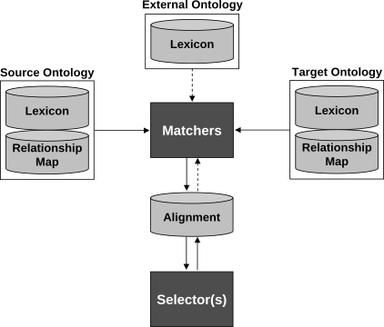
AgreementMakerLight
Flexible approach using
Matchers: compare two ontologies and return an Alignment between them
Selectors: trim an Alignment by excluding mappings below a given similarity threshold and excluding competing mappings
Source: Faria et al., http://disi.unitn.it/~p2p/RelatedWork/Matching/Feriae_AgreementMakerLight13.pdf

Slide 33


‘Naisc’ means ‘links’ in Irish and is pronounced ‘nashk’.
RDF Doc 1
Blocking
Strategy
Lens
Text
Feature
RDF Doc 2
Graph
Feature
Scorer
SPARQL
Constraint
Matcher
Highly flexible and configurable matching tool
Source: McCrae and Buitelaar http://www.cit.iit.bas.bg/CIT_2018/v-18-1/10_paper.pdf

Slide 34
Naisc Steps
Blocking Find the potential candidate alignments
Lens Find text features for element-level mapping
Text Features Use NLP to extract scores for element-level mapping
Graph Features Extract structure-level features
Scorer Estimate the likelihood of each alignment
Matcher Find best overall linking from scores
Constraints Specific rules such as unique assignment or reasoners

Slide 35
Conclusion

Slide 36
Key points
Element-level vs. Structure-level features
Element-level
Linguistic features
Logical features
External features
Structure-level features
Unique assignment
Graph link prediction
Scalability issues for alignment
Alignment as a multi-step workflow (LogMap2, AML, Naisc)

Slide 37
Further Reading
A Survey of Schema-based Matching Approaches. Shvaiko & Euzenat
http://eprints.biblio.unitn.it/701/1/087.pdf
Survey on complex ontology matching. Thiéblin et al.
http://semantic-web-journal.org/system/files/swj2164.pdf
Large-Scale Ontology Matching: State-of-the-Art Analysis. Ochieng and Kyanda
Available from Hardiman Library

